Slide 1


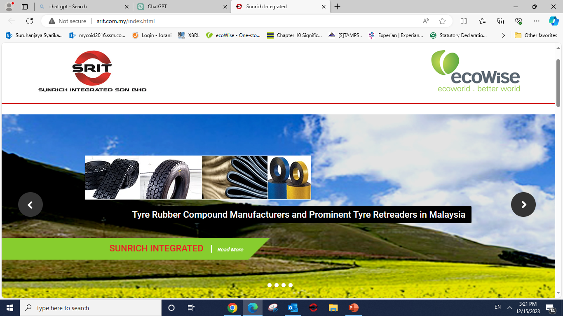
SUNRICH INTEGRATED GROUP
COMPANY PROFILE
6 NOVEMBER 2024
All rights reserved @ Sunrich Integrated Sdn. Bhd.(200901025321) (868423-T)

Slide 2
Corporate Video

Slide 3
A G E N D A
1.0
Company Background
1.1
1.2
1.3
1.4
1.5
About Us
Corporate Structure
Mission, Vision & Core Values
Brief introduction of Sun Rubber Industry Sdn. Bhd. (“SRI”)
Core Business, Products & Accreditation
2.0
SRI's Technical Capabilities
2.1 Machinery Capacity & Current Utilization
3.0
Introduction of SRI Plant 2
3.1
3.2
3.3
HF Intermeshing Technology & Product Backbone Overview of HF250 & Production Flow Intermeshing VS Tangential
4.0
R & D and Lab Facilities
5.0
Worldwide Distribution Market of SRI

Slide 4
ABOUT US
Sunrich Integrated Sdn. Bhd. (“SRIT Group”) is the wholly-owned subsidiary of Ecowise Holdings Limited, Singapore based in Malaysia. The principle activities of SRIT Group are as follows:-
Manufacturing of rubber compound and custom made compounds such as precured tread liners, cushion gum, perforated sidewall veneer and rubber masterbatch for tyre retreading, industrial belting and other industries;
Retreading of tyres and total tyre management services. The Group manufactures retread tyres under brand names such Suntex and Autoways through its marketing arms; and Manufacturing of specialty rubber compounds for the IT, automotive and other industries.

Slide 5

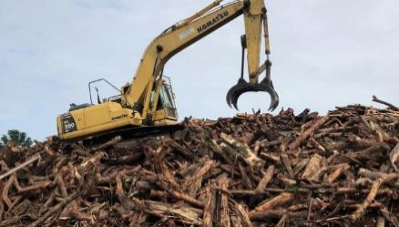
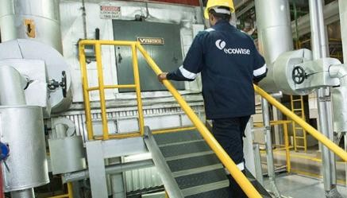
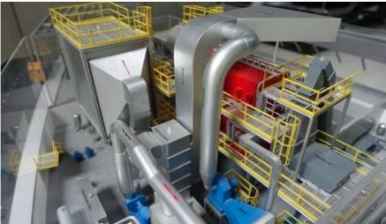
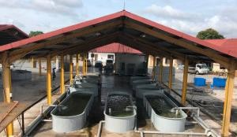









BUSINESS OVERVIEW
Four Main Business Arms
Resource Recovery
Rubber Compound Manufacturing & Tyre Re-Treading - Malaysia
Waste Tyre Re-treading & Total Tyre Management Services – Chongqing, China
Renewable Energy
Wood Waste Burnt to Generate Electricity in Gardens by the Bay, Singapore
Integrated Environmental Management Solutions
Provide end-to-end environmental management solutions that cater to every point of the waste management value chain.
Research and
Development (R&D)
High-tech Integrated Sustainable Aqua and Agricultural Park - ecoWise Rongyao Ecotech Park, Singapore
Co-generation Biomass Power Plant @ Sungei Kadut, Singapore
Copper Slag Recycling
Animal Feed Additives & Ingredients
Biomass Fuel Preparation and Composting
Electrical & Electronic Waste Management

Slide 6

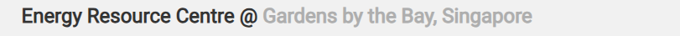
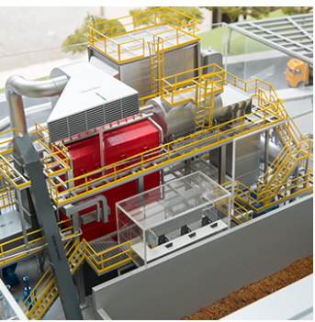
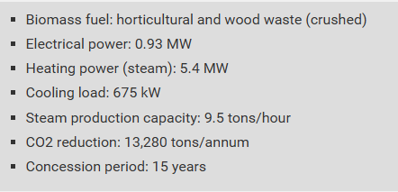
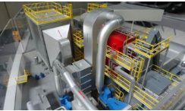

Slide 7





CORPORATE STRUCTURE
New Tyre & TMS Services
Rubber Compounding
Retreading
Sunrich Tyre and Auto Products Sdn. Bhd.
Sun Rubber Industry Sdn. Bhd.
Sun Tyre Sdn. Bhd.
Retreads Marketing Units
Sunrich Marketing Sdn. Bhd.

Slide 8
VISION
To be an organization of Increasing Values to all Stakeholders.
To recognize eco-friendliness as vital elements in our manufacturing; offering of Product and Services and Technology Development.
MISSION
Excellent Service, Quality, & Pricing to our valued customers.
Create a Brand Name Recognition
Optimize & Sustain Returns to all Stakeholders
With our belief in Integrity and Professionalism in our business deals
Instill a Cohesive Culture with Respect, Cooperation, Participation, Communication and Interaction among all levels
Social Commitment to Community, Safety & Health and Environmental Friendliness
Ensure continuous Research & Development of Ingenious Technology for tomorrow needs
CORE VALUES
Strength & Determination
Resourcefulness & Innovation
Integrity & Accountability
Teamwork & Passion

Slide 9
SUN RUBBER INDUSTRY SDN. BHD.
Sun Rubber Industry Sdn. Bhd. (“SRI”) was incorporated in 1980, is a wholly-owned subsidiary of SRIT.
SRI is one of the largest & leading rubber compound manufacturer for Tyre Compound – Both new and retreads, Industrial Rubber Goods & General Rubber Goods in Malaysia.
We engaged in designing, research and development, manufacturing, product testing and distribution of rubber compounds which currently supplied to domestic and international market covering China, Asia Pacific, Oceania, Middle East, Africa and Europe.
SRI is also equipped with an advanced mixing plant from Germany.

Slide 10
CORE BUSINESS
Specialize In Tyre compound for New & Retreads
Custom Mix For Industrial Rubber Goods & General Rubber Goods Manufacturers

Slide 11
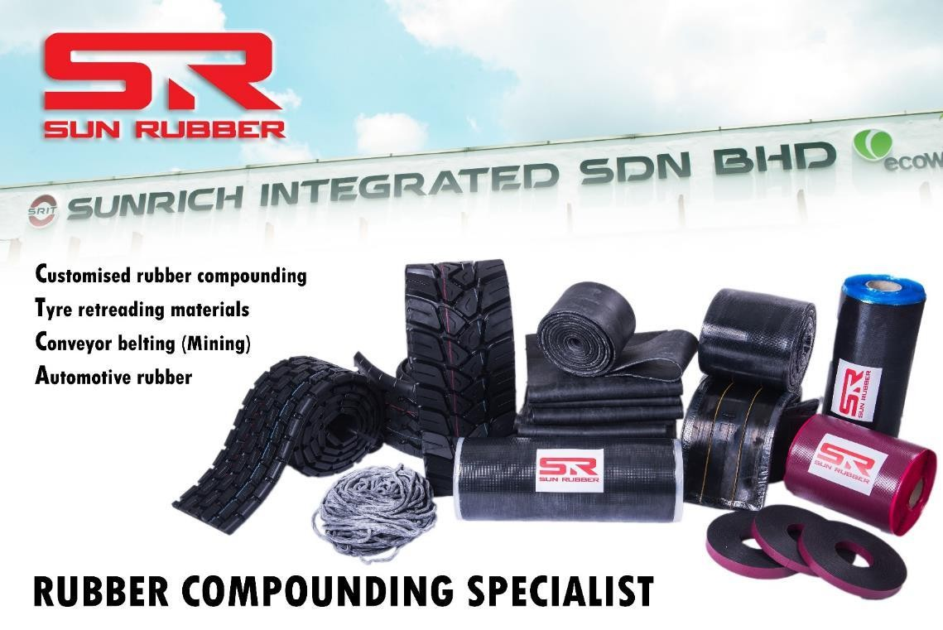

RETREADS PRODUCT RANGE
Product Range:
Precured Tread Liners
Cushion Gum
Gum Cord
Sidewall Veneer
Orbitread Compound
Camelback Compound
Masterbatch
Custom Mixed Compound, etc
Accreditation:

Slide 12
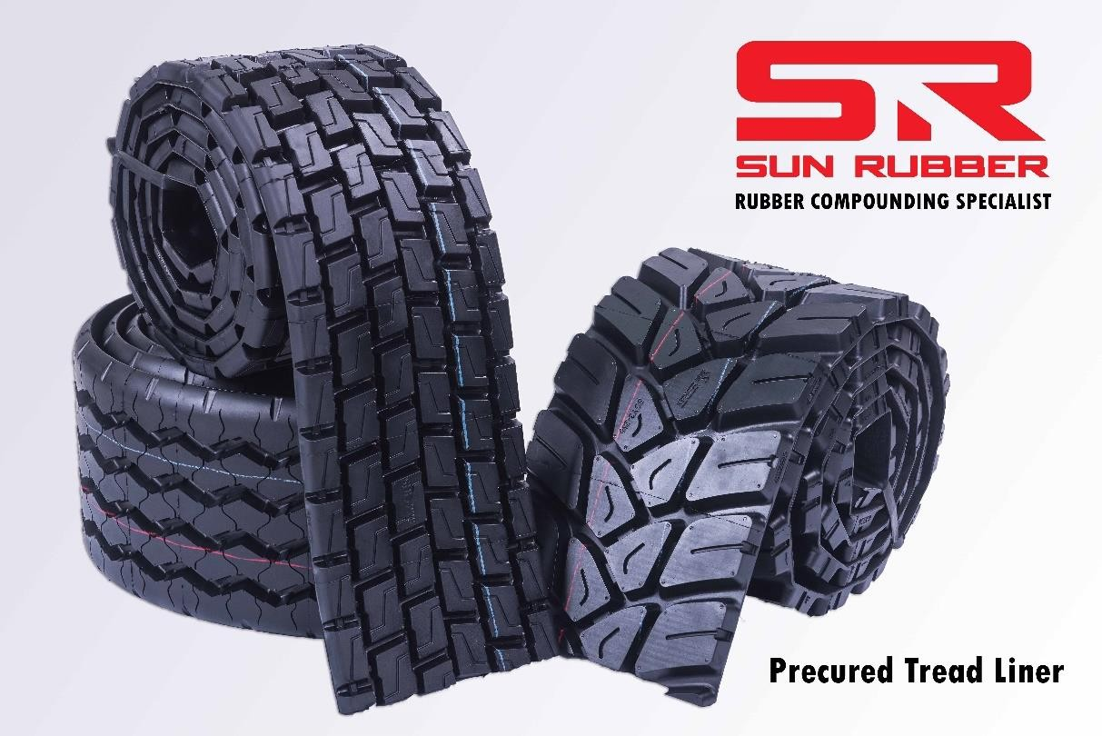
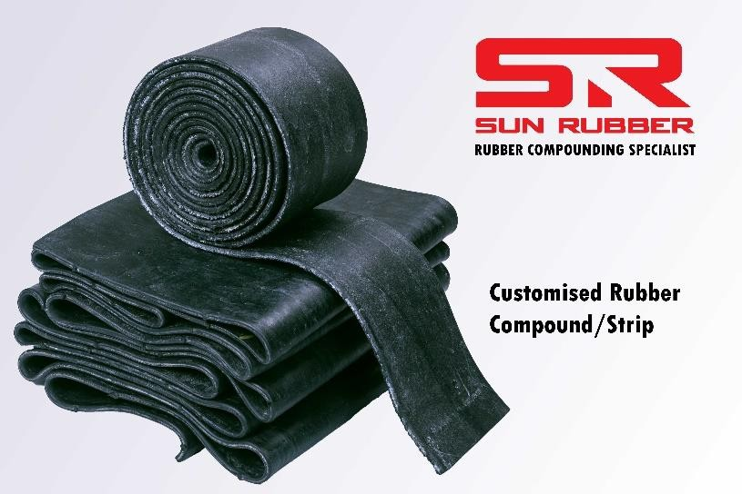
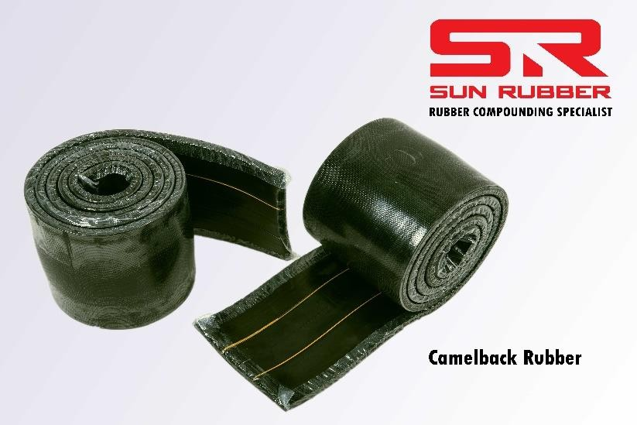
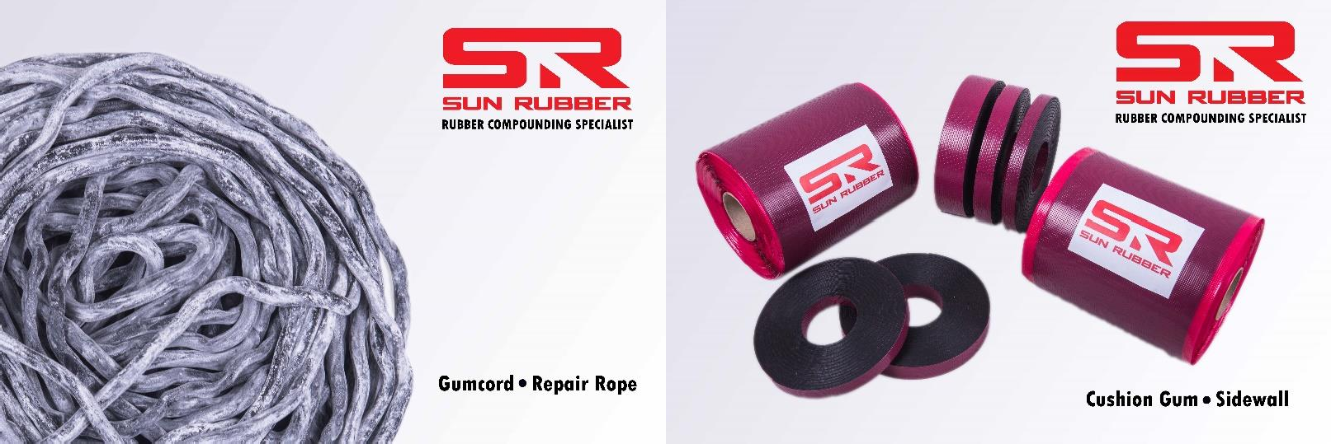

Slide 13





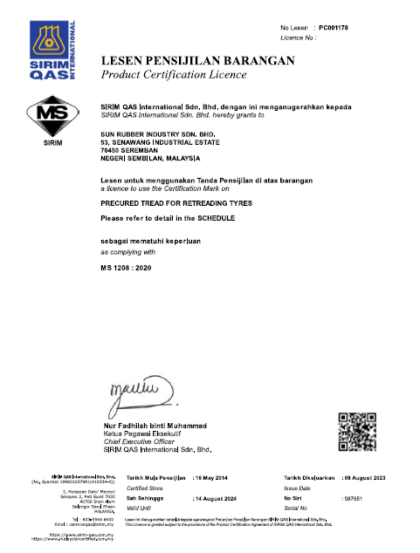
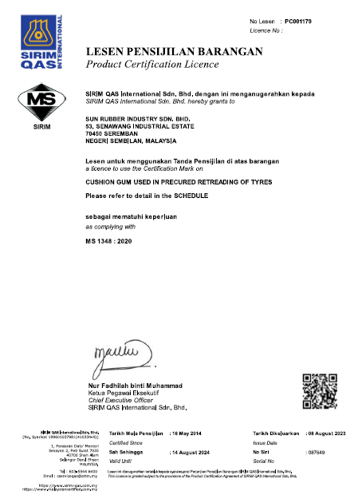
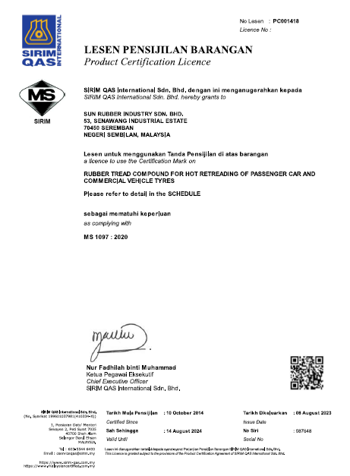
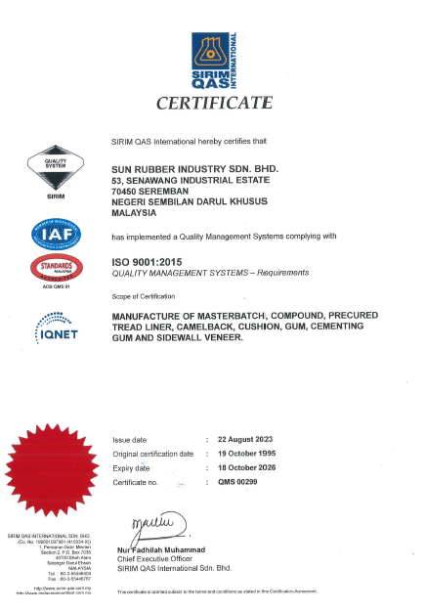
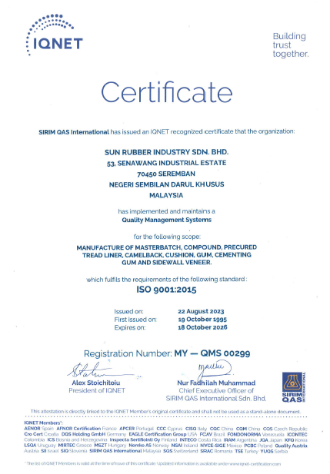
ACCREDITATION
MS 1208 : 2020
MS 1348: 2020
MS 1097: 2020
MS 9001: 2015
IQN 9001: 2015

Slide 14
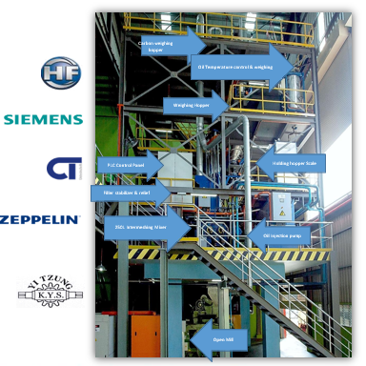
MACHINERY CAPACITY
Machine | Monthly Capacity
Banbury GK 270 – Tangential (270 Liter) MK 6 – Tangential (160 Liter) HF 250 – Intermeshing (250 Liter) | 3,500 Tonne (Single Stage)
Extrusion 6” – Cold Feed 6” – Cold Feed (NEW) 8” – Hot Feed | 772 Tonne
PTL Moulding (5presses) 11m – 1 unit, 5m – 1 unit, 3.8m - 1 unit, 3.5m – 2 units | 480 Tonne (Equals to 37,000 truck tyres)
PTL Sanding (4 units) | 530 Tonne
Calendaring (44”) | 120 Tonne

Slide 15
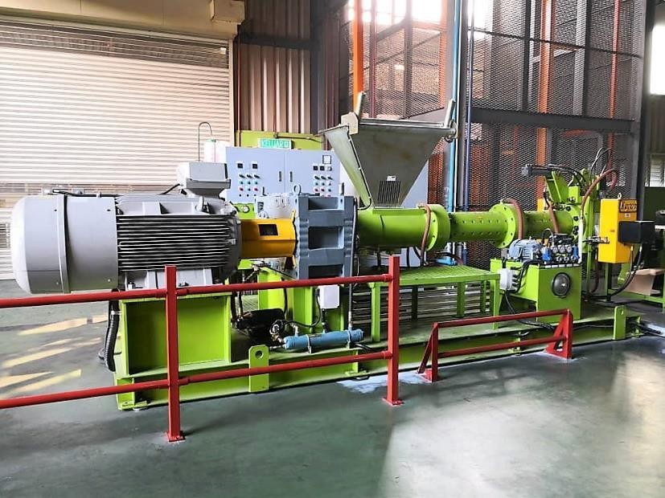
Machinery Capacity
Machine | Monthly Capacity
Banbury GK 270 – Tangential (270 Liter) MK 6 – Tangential (160 Liter) HF 250 – Intermeshing (250 Liter) | 3,500 Tonne (Single Stage)
Extrusion 6” – Cold Feed 6” – Cold Feed (NEW) 8” – Hot Feed | 772 Tonne
PTL Moulding (5presses) 11m – 1 unit, 5m – 1 unit, 3.8m - 1 unit, 3.5m – 2 units | 480 Tonne (Equals to 37,000 truck tyres)
PTL Sanding (4 units) | 530 Tonne
Calendaring (44”) | 120 Tonne
NEW Extruder, Aug 2018

Slide 16
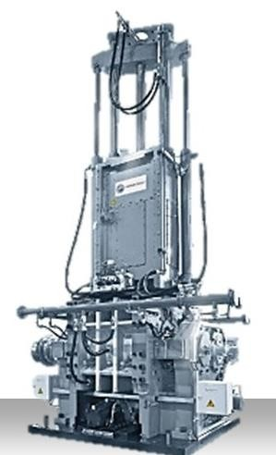

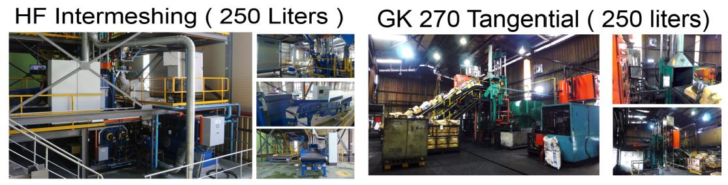
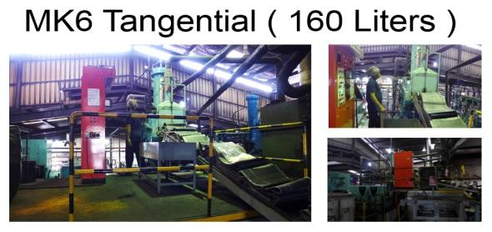
Current Utilization (Monthly)
Machinery | Machinery Full Capacity (Tonnes) | Current Output (Tonnes) | Capacity Utilization | Capacity Available
Mixing | 3,500 | 1,400 | 40% | 60%
Extrusion | 772 | 350 | 46% | 54%
PTL | 480 | 230 | 48% | 52%
Calendaring | 120 | 40 | 34% | 66%
#Capacity utilization based on 24 hours non-stop.

Slide 17
Introduction of SRI Plant 2

Slide 18
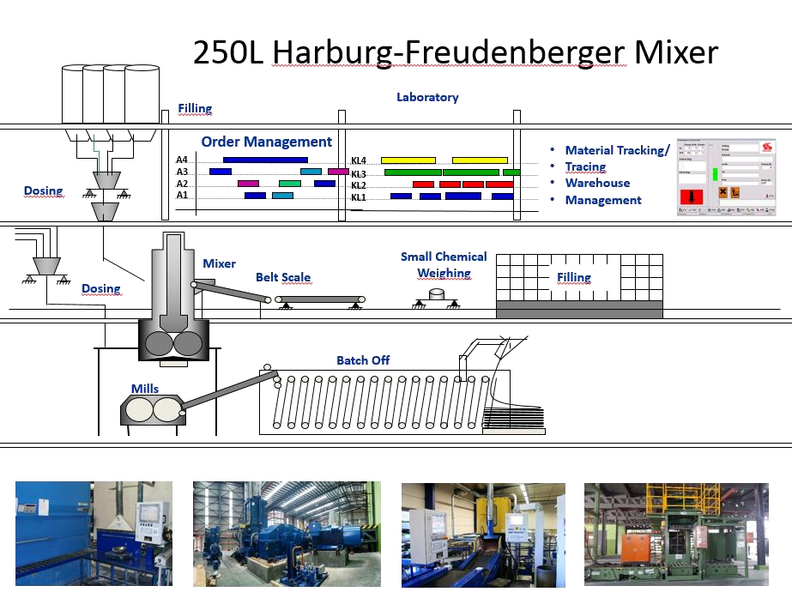
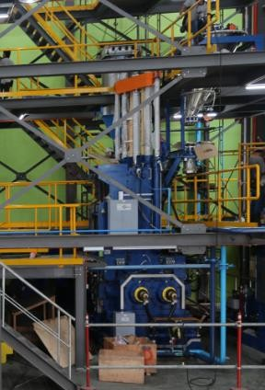
TECHNOLOGY & PRODUCT BACKBONE

Slide 19

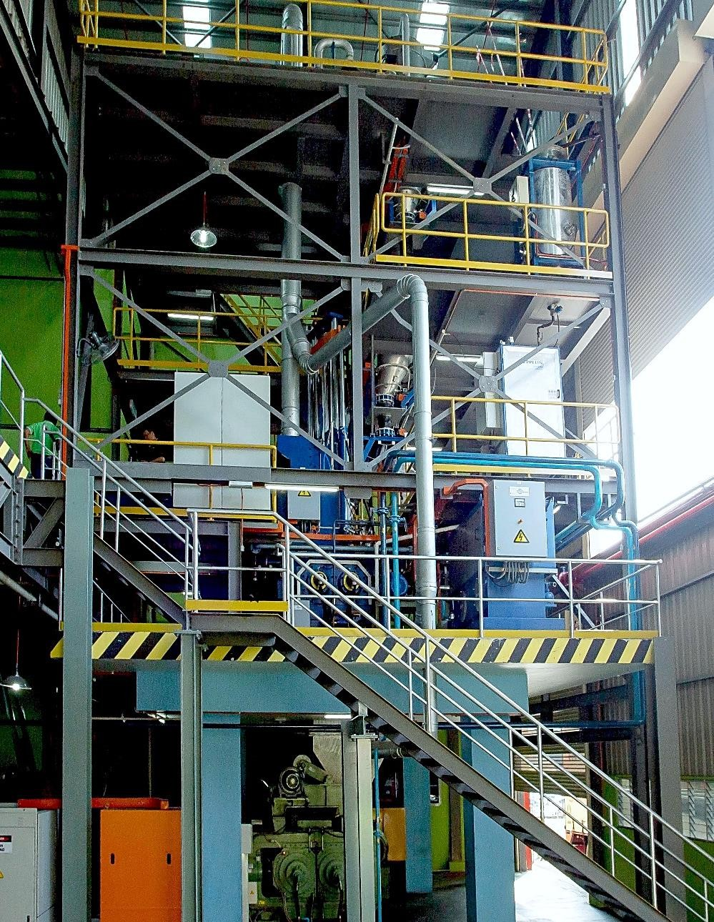




Overview of HF250
Mixer : Harburg Freudenberg (HF)
Carbon weighing hopper
Inverter Motor : Siemens, 1320 KW, 1500 rpm
Capacity: 260L
Type: Intermeshing
Oil Temperature control & weighing
Features :-
Controllable Ram speed (rpm)/ movement/ position , mixing or feeding sequence, variable temperature are fully automated.
Weighing Hopper
Downstream:
Open Mill : Yi Tzung- 84"
Feed Mill : Dalian- 60“
Cooling Tower (400T)
PLC Control Panel
Holding hopper Scale
Filler stabilizer & relief
Automation :
Control System by : CT Datentechnik GmbH
Material feeding system by : Zeppelin
Stringent and precision control as fully automated stars from Ingredient planning, chemical weighing,
feeding system, operating sequence, temperature, speed.. fully computerize.
250L Intermeshing Mixer
Oil Injection pump
Benefits to our customer:
Good output efficiency and quality controlled to meet specification.
The intermech rotors is very ideal for more advance high tech and valued compounds.
Fast and higher tensile mPa can be achievable.
Preventive failure due to carbon and dust pollution from the total control system is minimized. Thus, the state of art inverter motor also used less energy which reduced heat generation. Go Green.
Open Mill

Slide 20
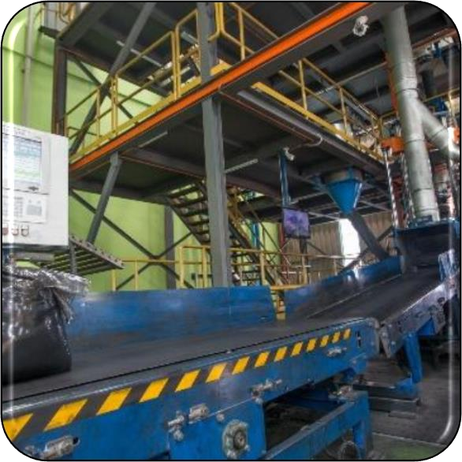
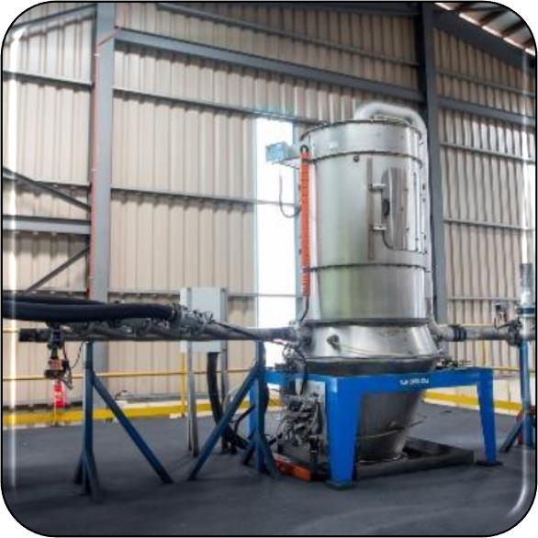
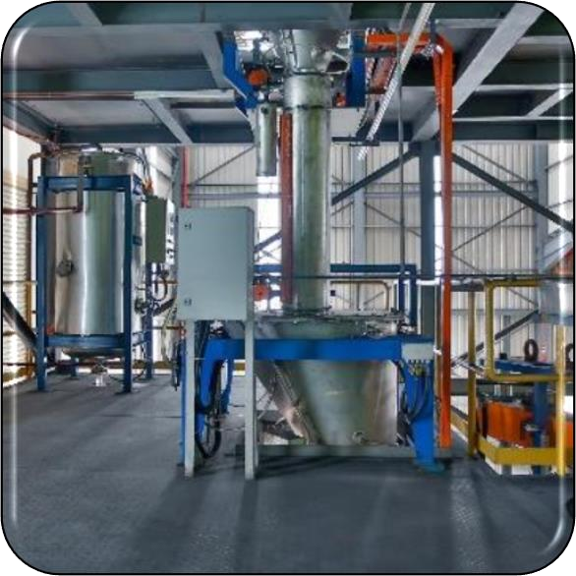
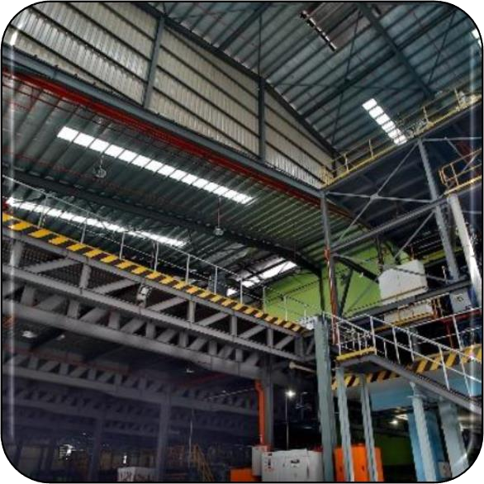
Production Flow
1. Polymer chemical load
onto weighing scale conveyor.
2. Carbon black automatic
load into hopper.
3. Process oil load
automatic into weighing scale and ready to inject.
4. Mixing start according
to its programmed speed, time & temperature.

Slide 21
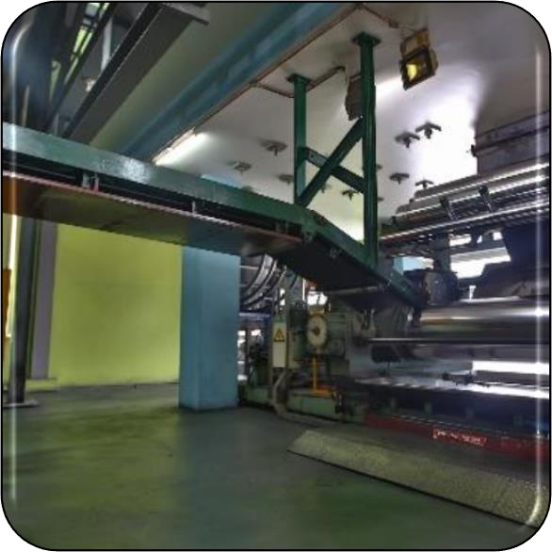
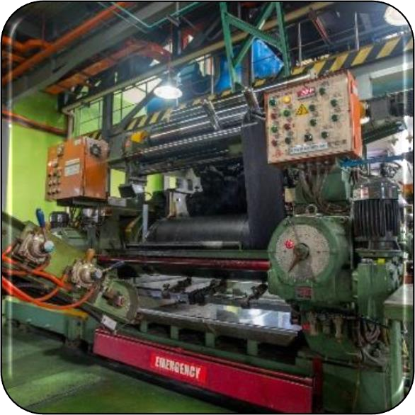
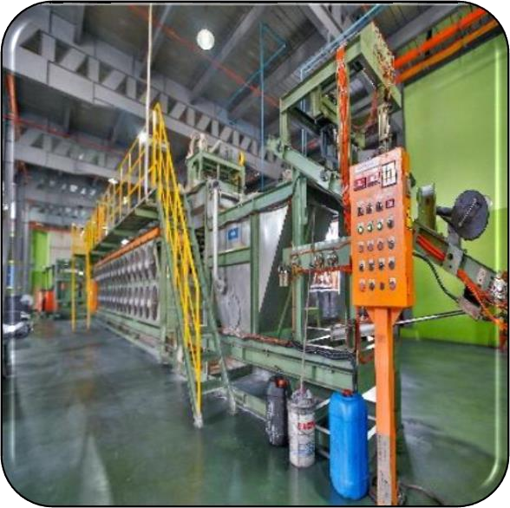
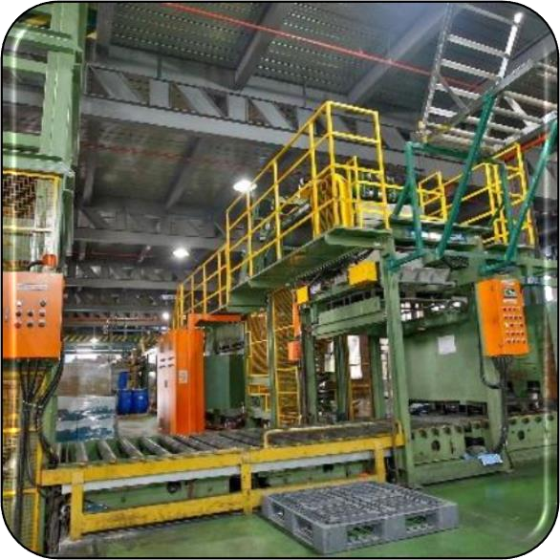
Process Flow
5. Mixed rubber is
dropped onto the 84” mill for cooling & blending.
6. The rubber is sheet out
to desire width and thickness and transfer to batch off machine.
7. Rubber slab in
continuous length is dipped through anti-tack before enter the batch-off machine.
8. Cooled & dried rubber
slap is stacked in wig-wag form onto pallet

Slide 22
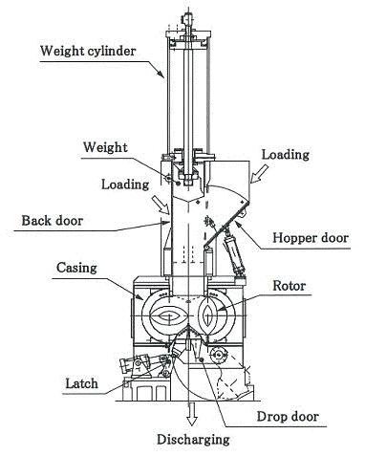
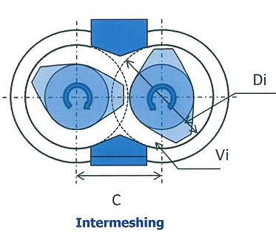
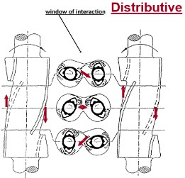


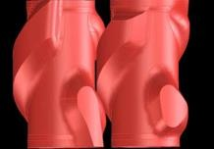
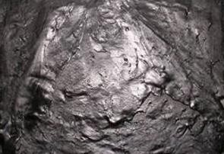
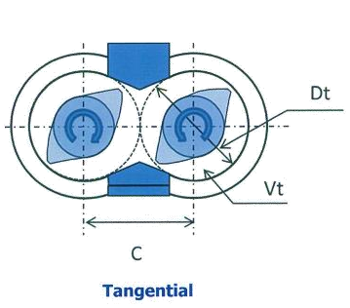
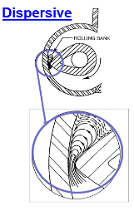


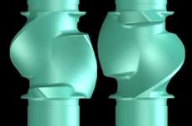

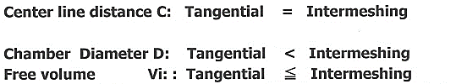
Mixing Performance of SRI Intermeshing vs Tangential
Mixing Performance of SRI Intermeshing vs Tangential Mixers:
Efficient cooling during mixing
Improved black dispersion & distribution performance
Better temperature control
More homogeneous mix with intermeshing vs tangential mixers
Able to mix effectively for high performance rubbers

Slide 23

R&D Laboratory
Quality Control Laboratory

Slide 24
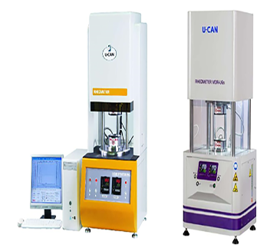
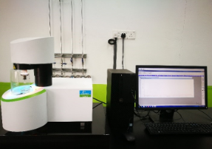
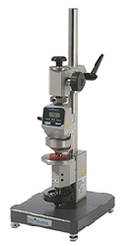
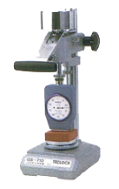
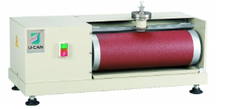
QUALITY CONTROL & TESTING FACILITIES
Thermogravimetric Analyzer
Mooney Viscosity and Mooney Scorch Test
Rheological test machine
Durometer Hardness Test
IRHD Hardness
Abrasion Resistance Test

Slide 25
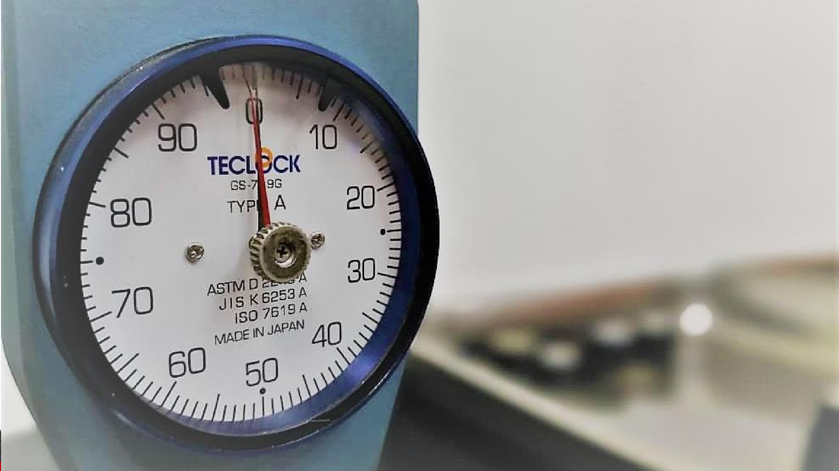

LAB FACILITIES
Durometer (TECLOCK-CG-719G)
Electronic Densimeter (MIRAGE-MD-200S)
Digimatic Indicatior ( Precise)
Electronic weighing scale (Vibra-HT224R)
Durometer (Shore A)- (TECLOCK-GS-719H)
Rheometer ( Eekon -EK-100H)
Tensometer (Eekon-TS-1000 )
Mooney Viscometer (U-CAN-UM2050)
MDR Rheometer (U-CAN-UR2010)
Din Abrasion Tester (U-CAN-U A-2076)
Thermometer with surface sensor (HOTTEMP-HT-305)
Durometer (IRHD)- (Bareiss-BS-09)
Lab Oven –(Carbolite-PF60/TR32)
Digital Caliper- (Mitutoyo )
Thermogravimetric Analyzer
Resilience Elasticity Tester
Flexometer
De MattiaFlex Cracking Machine
www.srit.com.my

Slide 26






WORLDWIDE DISTRIBUTION MARKET
Australia
EURO
Asia
Pacific
Africa Continent
Middle
East

Slide 27
Thank you

