Slide 1
Sun Rubber Web Architecture Design
Draft by: BenFoo

Slide 2
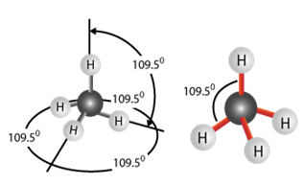

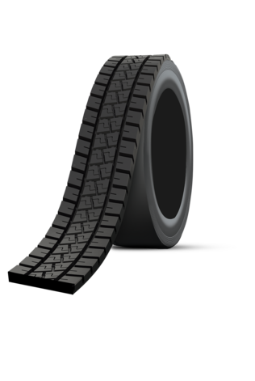

Main Page Design and Tag-line
LOGO
Home
Let’s Connect
Products
News
R&D
About
ENG
Compounding
Masterbatch
Discovering Rubber’s Potential
Tread Liner
OB Strips
Camelback
Cushion Gum

Slide 3


Product’s Enquiry Workflow (Click on Home picture or Products)
Type of Rubber product & Application Selection
Specifications & Configurations
Compounding Processing
Send Enquiry Via Email/WhatsApp
Masterbatch
Hardness
Shore A
Moulding
Density
g/cm3
Thickness mm
Compounding
Din Abrasion
mm3
Flat Length mm
Tensile min
MpA
Retread Tyre Components
PTL Liner -Sizes
Cushion Gum
Camelback
OB Strips
Width cut mm
EB %
%
Tear Strength min
Kn/m
Extrusion
Curing time mins/c
mins/c
Thickness mm
PTL Liner Patterns
Flat Length mm
Width cut mm

Slide 4
Main Page Design and Tag-line
LOGO
Home
Let’s Connect
Products
News
R&D
About
ENG
Upstream Products
Downstream Products
Masterbatch
Retread Tyre Components
PTL Liner -Sizes
Cushion Gum
Camelback
OB Strips
Compounding

Slide 5
Main Page Design and Tag-line
LOGO
Home
Let’s Connect
Products
News
R&D
About
ENG
MS 1208:2020 (Sun Rubber) - Precured Tread for Retreading Tyres
MS 1348:2020 (Sun Rubber) - Cushion Gum used in Precured Retreading of Tyres
MS 1097:2020 (Sun Rubber) - Rubber Tread Compound for Hot Retreading for Passenger car and Commercial Vehicles Tyres
Action Picture and the team photos

